Slide 1
Chat Application
Using HTML, CSS, JavaScript

Slide 2
Project Objective
Goal: Build a real-time communication platform that mimics popular messaging apps, allowing users to interact in real-time within different chat rooms.
Real-Time Communication: WebSocket's will ensure a seamless communication experience without requiring page reloads, keeping the chat flow uninterrupted.
Scalability: Ensure that the app can accommodate a growing number of users, handling real-time message exchanges efficiently.

Slide 3
Detailed Features
Room Interface: Each chat room will have its own message area, an input field to type messages, and a list of members present in the room.
Message Formatting: Messages will be displayed with bold, italic, and hyperlinks for better expressiveness.
Dynamic Room List: The room list will update in real-time, showing new rooms as they are created.
Responsive Layout: The layout will adapt based on screen size using CSS media queries and flexible grids, ensuring usability across devices.

Slide 4
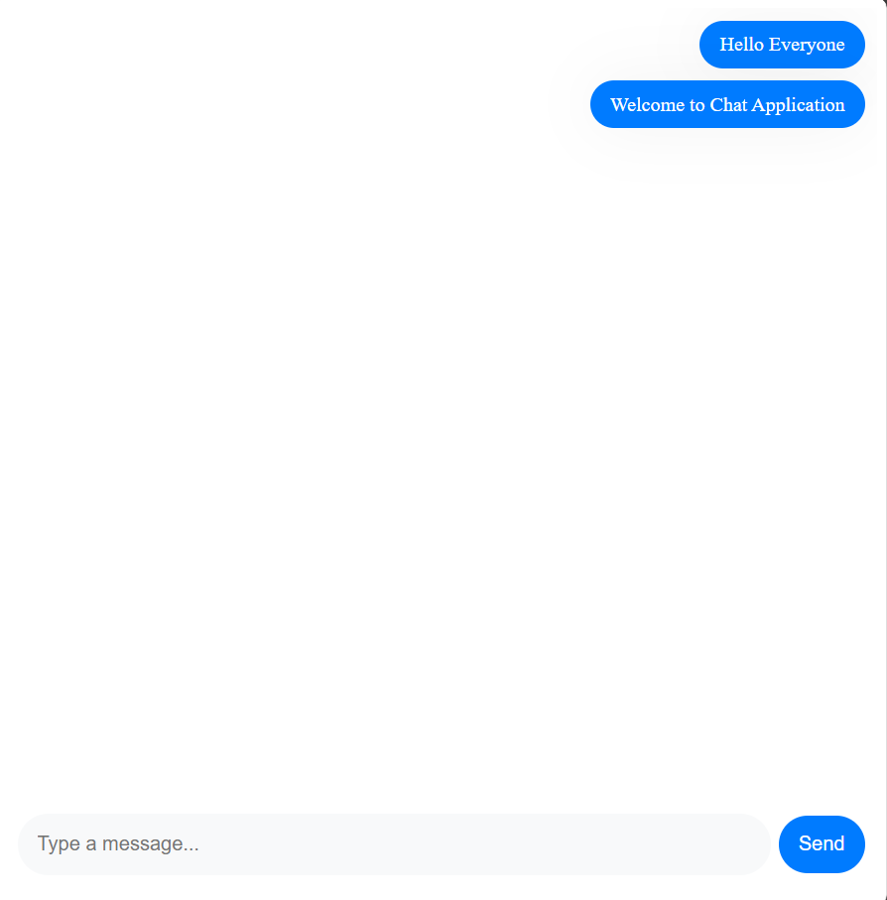
The Chat page

Slide 5
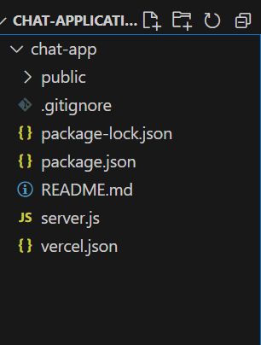
Project File Structure

Slide 6
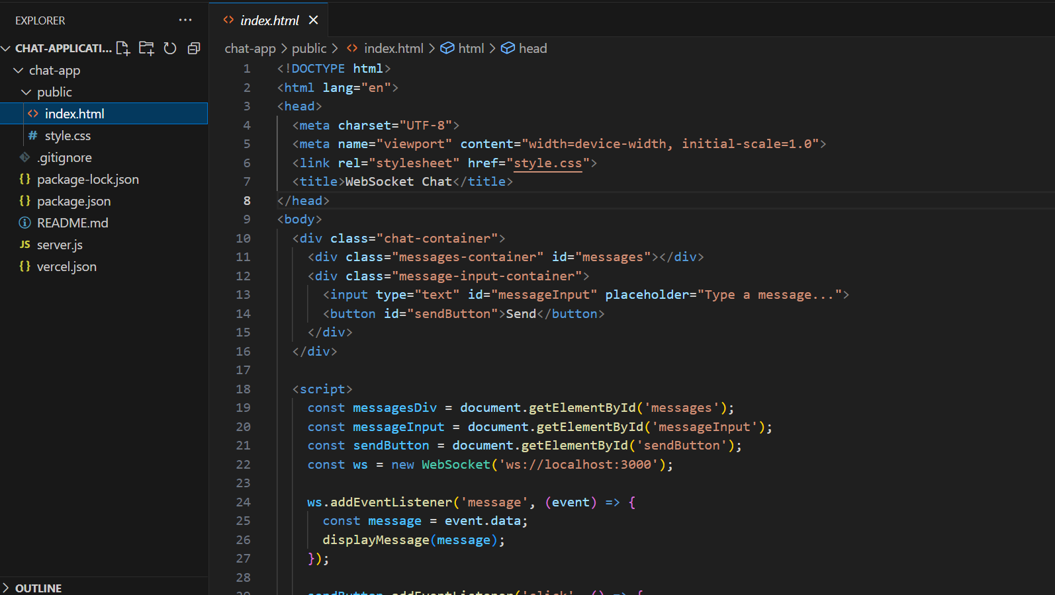

Slide 7
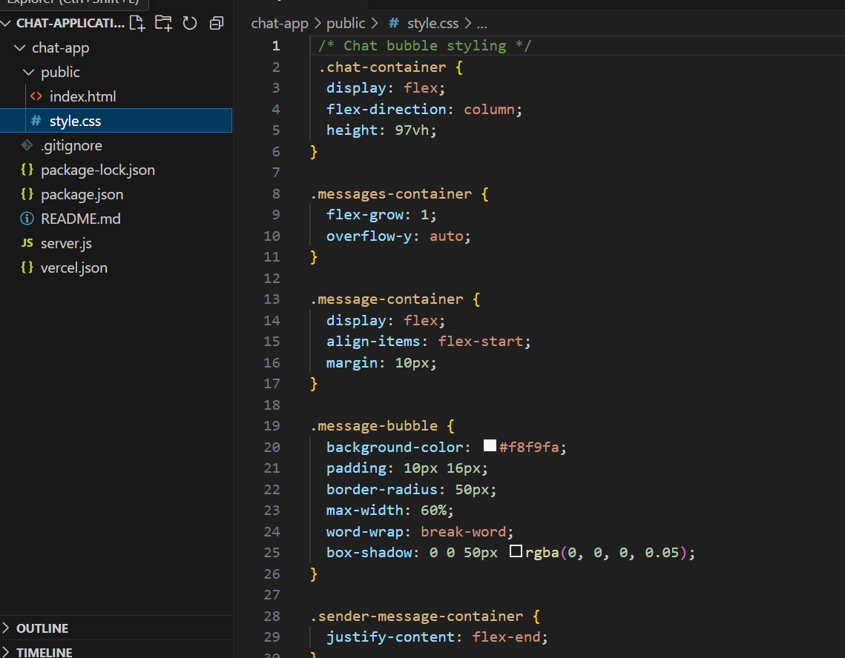

Slide 8
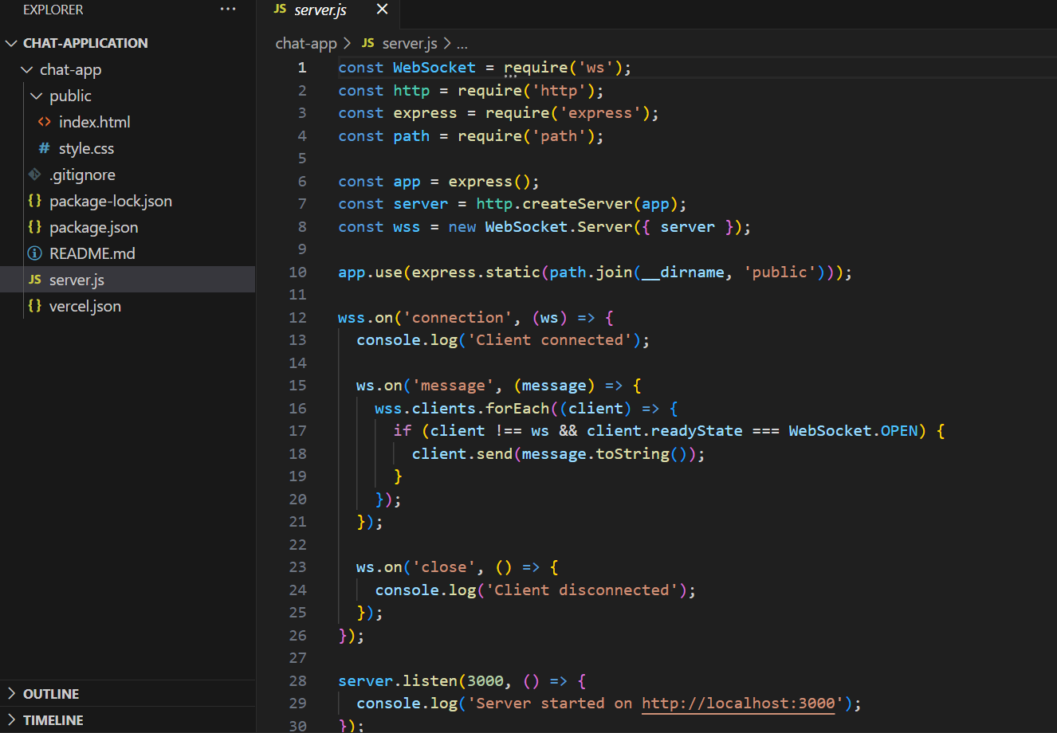

Slide 9
Security and Edge Cases
Data Validation: Use regex to validate usernames, ensuring they don't contain forbidden characters or exceed character limits.
Authentication Security: You can implement basic session management (e.g., using cookies or localStorage) to keep users logged in across sessions.
Handling Disconnections: If a user disconnects, gracefully handle the disconnection by notifying others in the room and possibly restoring their state if they rejoin.

Slide 10
Challenges and Solutions
Challenge: Real-Time Messaging:
Maintaining real-time communication across multiple users can be complex, especially when handling disconnections.
Solution: Use WebSockets to ensure instant updates without reloading the page. Store message data on the server to ensure continuity if a user disconnects and reconnects.
Challenge: UI Consistency:
Ensuring the design is responsive and works seamlessly across different devices.
Solution: Use media queries and flexible layouts, thoroughly testing on various screen sizes (mobile, tablet, desktop).

Slide 11
Conclusion
Highlight the impact of building a real-time chat application, from improving communication to gaining hands-on experience with WebSocket's and real-time data flow.
Emphasize the importance of smooth UI/UX for maintaining user engagement.

